Slide 1
Weather image recognition
Amarthaluru Venkateswara Rohit Roy
Ganesh Suhas Shinde
Rohith Surya Podugu
Shubham Deepak Pawar
Tanmay Sure
Yaswanth Madanapalli
Keerthana Veena
Sagar Addala Ram
CS 5661 Final project presentation

Slide 2
DATASET
Dew
Fog smog
Frost
Glaze
Hail
Lightning
Rain
Rainbow
Rime
Sandstorm
Snow
Number of classes - 11
Link -https://www.kaggle.com/datasets/jehanbhathena/weather-dataset

Slide 3
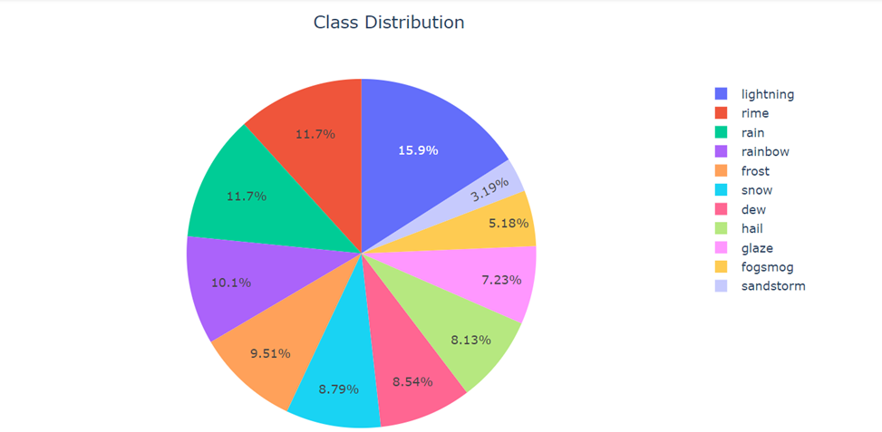
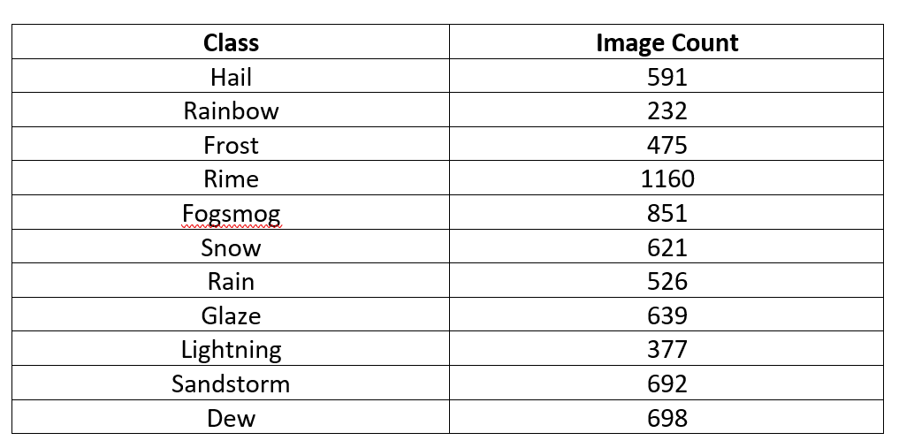
DATASET
Link -https://www.kaggle.com/datasets/jehanbhathena/weather-dataset

Slide 4
Algorithm implemented
MobileNet
ResNet50
Xception-Net
EfficientNet B0
VGG16
VGG19

Slide 5
MobileNet
It is efficient convolution neural networks for mobile vision applications
This function returns a Keras image classification model, optionally loaded with weights pre-trained on ImageNet

Slide 6
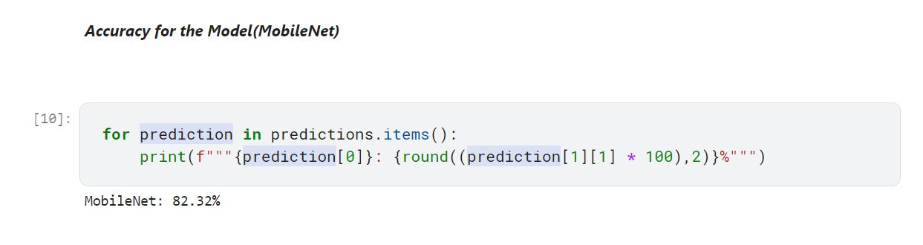
Accuracy for MobileNet

Slide 7
2. Resnet50
Keras resnet50 is nothing but a residual neural network that is a classic neural network that was used as the backbone of multiple computer tasks

Slide 8
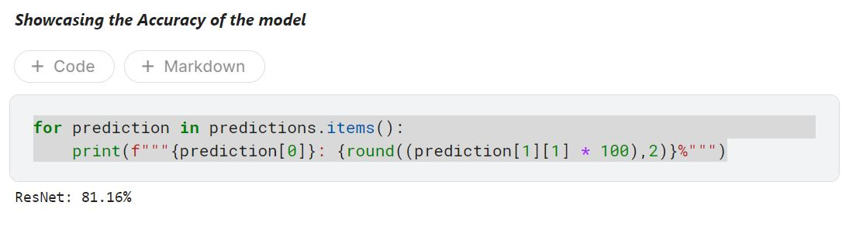
Accuracy for model(Resnet50)

Slide 9
3. Xception-net
Used pre-trained Xception Net Model, trained on ImageNet dataset
Fine-tuned it's weights on our dataset to achieve high accuracy

Slide 10
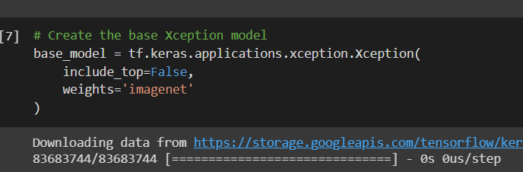
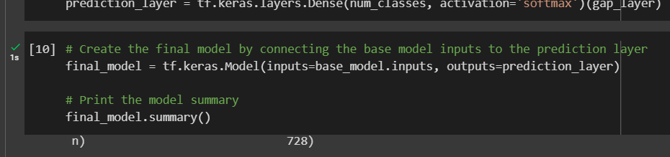
Implementation details (Xception-net)
Importing the pre-trained model as our base model. Not including the last(include_top) layer
Fine-tuning the weights for the prediction layer

Slide 11
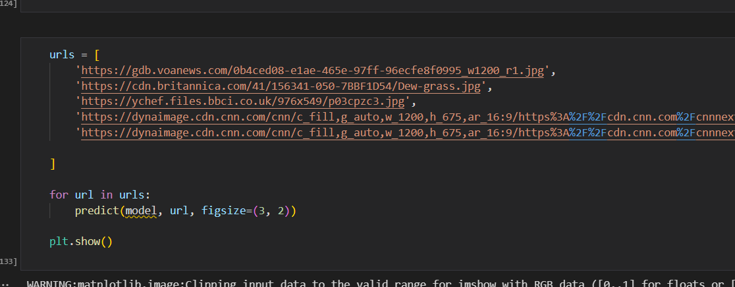
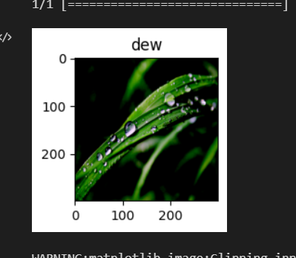
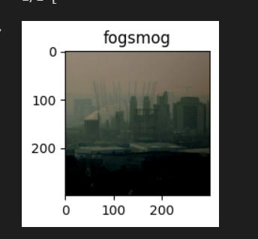
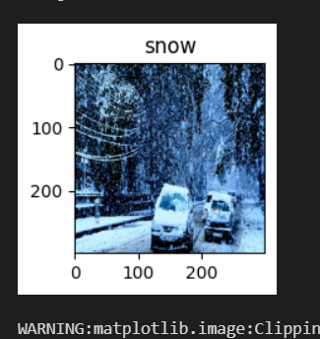
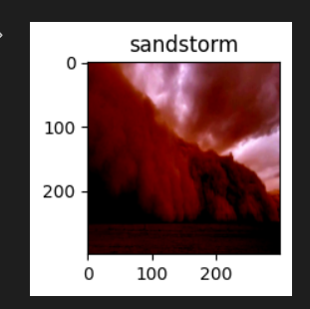
Predictions

Slide 12
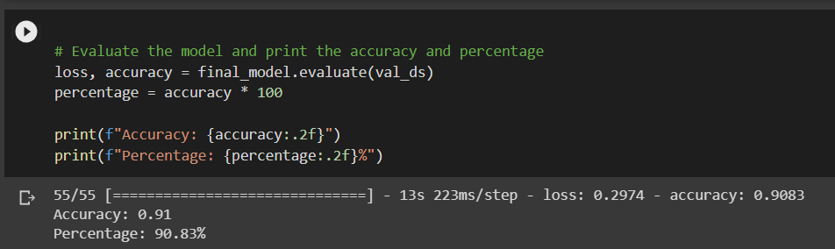
Accuracy for model(Xception-net)

Slide 13
4. Efficientnetb0
EfficienHtNetB0 is a convolutional neural network that is trained on more than a million images from the ImageNet database
tf.keras.applications.efficientnet.EfficientNetB0

Slide 14
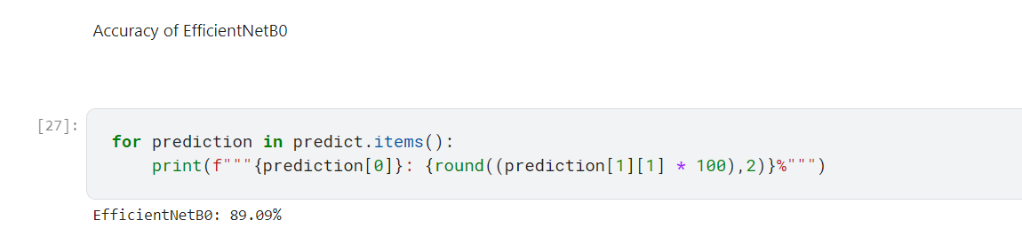
Accuracy for model(Efficientnetb0)

Slide 15
5. vgg 16

Slide 16
VGG 16
The 16 stands for the 16 layers of the architecture of the algorithm.
The algorithms that were before VGG 16 had many hyper-parameters that needed to be configured for conv and pooling layers.
In VGG 16, the layer and pooling layers have fixed sizes.
Conv Layer: 3 x 3 filter, stride=1, same padding
Max Pooling: 2 x 2, stride = 2

Slide 17
VGG 16 Implementation Details
Used 120 x 120 input size instead of the default 224x224 input size.
Used the Adam optimizer and Reduce Learning Rate as optimizers and hyperparameter tuners for better gradient descent and convergence.
Image Data generator is used to augment new data by zooming and rotating the images, therefore reducing overfitting of data.

Slide 18
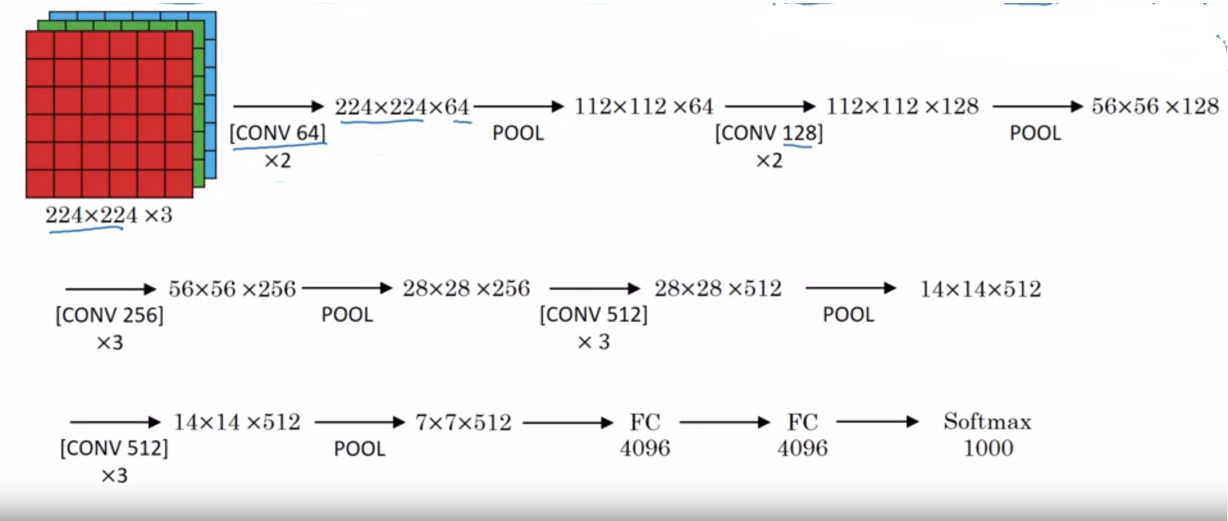
VGG Architecture

Slide 19
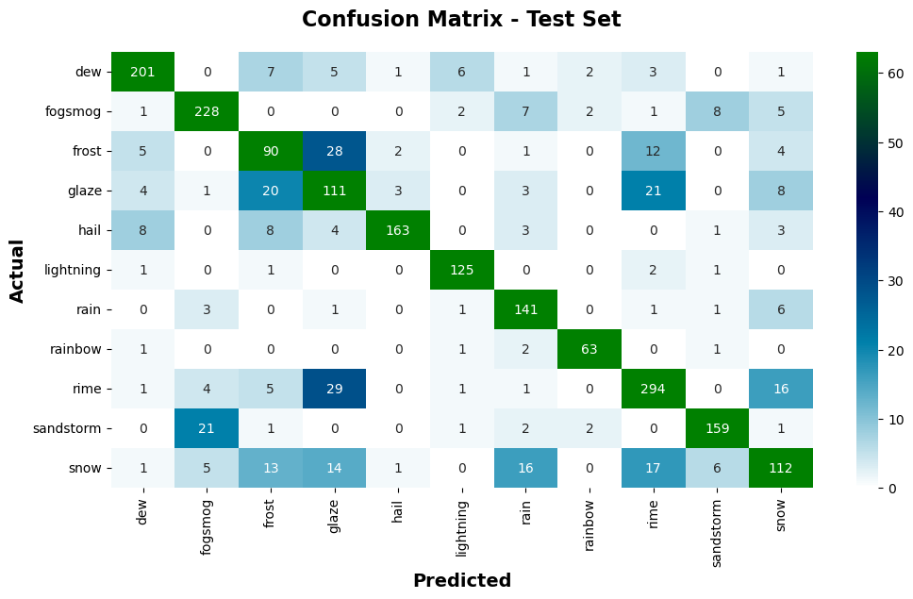
Confusion Matrix

Slide 20
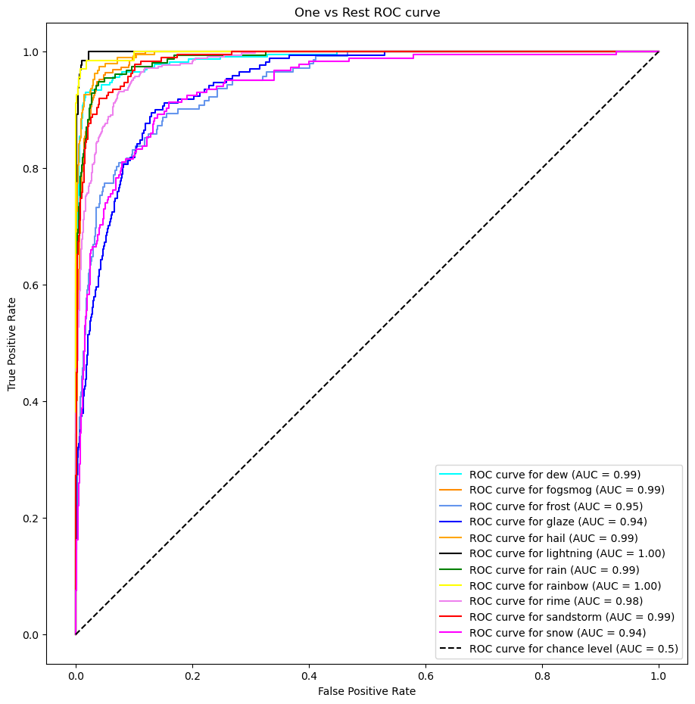
ROC Curve (One vs REST)

Slide 21
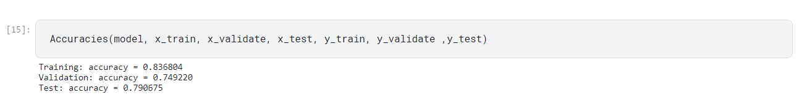
AccurACY FOR MODEL (VGG16)

Slide 22
6. Vgg 19
from tensorflow.keras.applications.vgg19
The default input size for this model is 224x224.

Slide 23
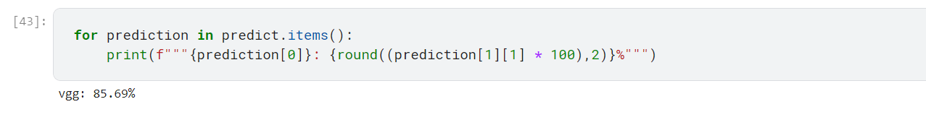
Accuracy for model(VGG19)

Slide 24
CONCLUSION
We got the best accuracy from : Xception-Net
Accuracy we got is - 90.6%

Slide 25
THANK YOU

